Slide 1
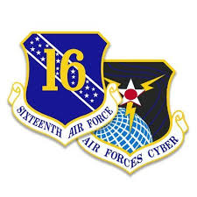

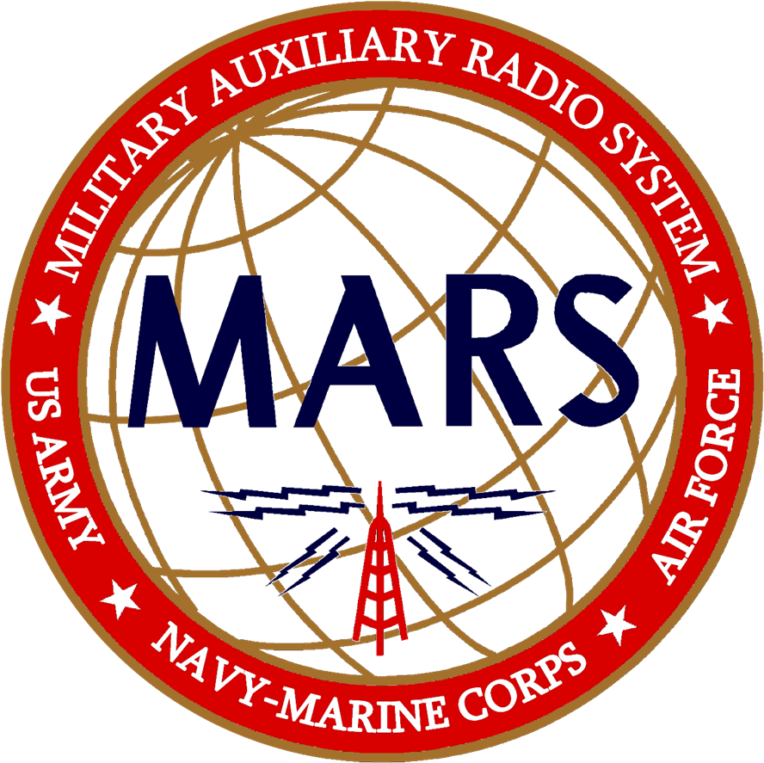
A Official Presentation of
United States Airforce MARS
Public Affairs Office
Approved for Public Release
UNCLASSIFIED
Contains No FOUO Information
Presentation 19-DoD-AFM-5236K © 2020 USAF MARS, All Rights Reserved, Unauthorized Duplication is Strictly Prohibited

Slide 2

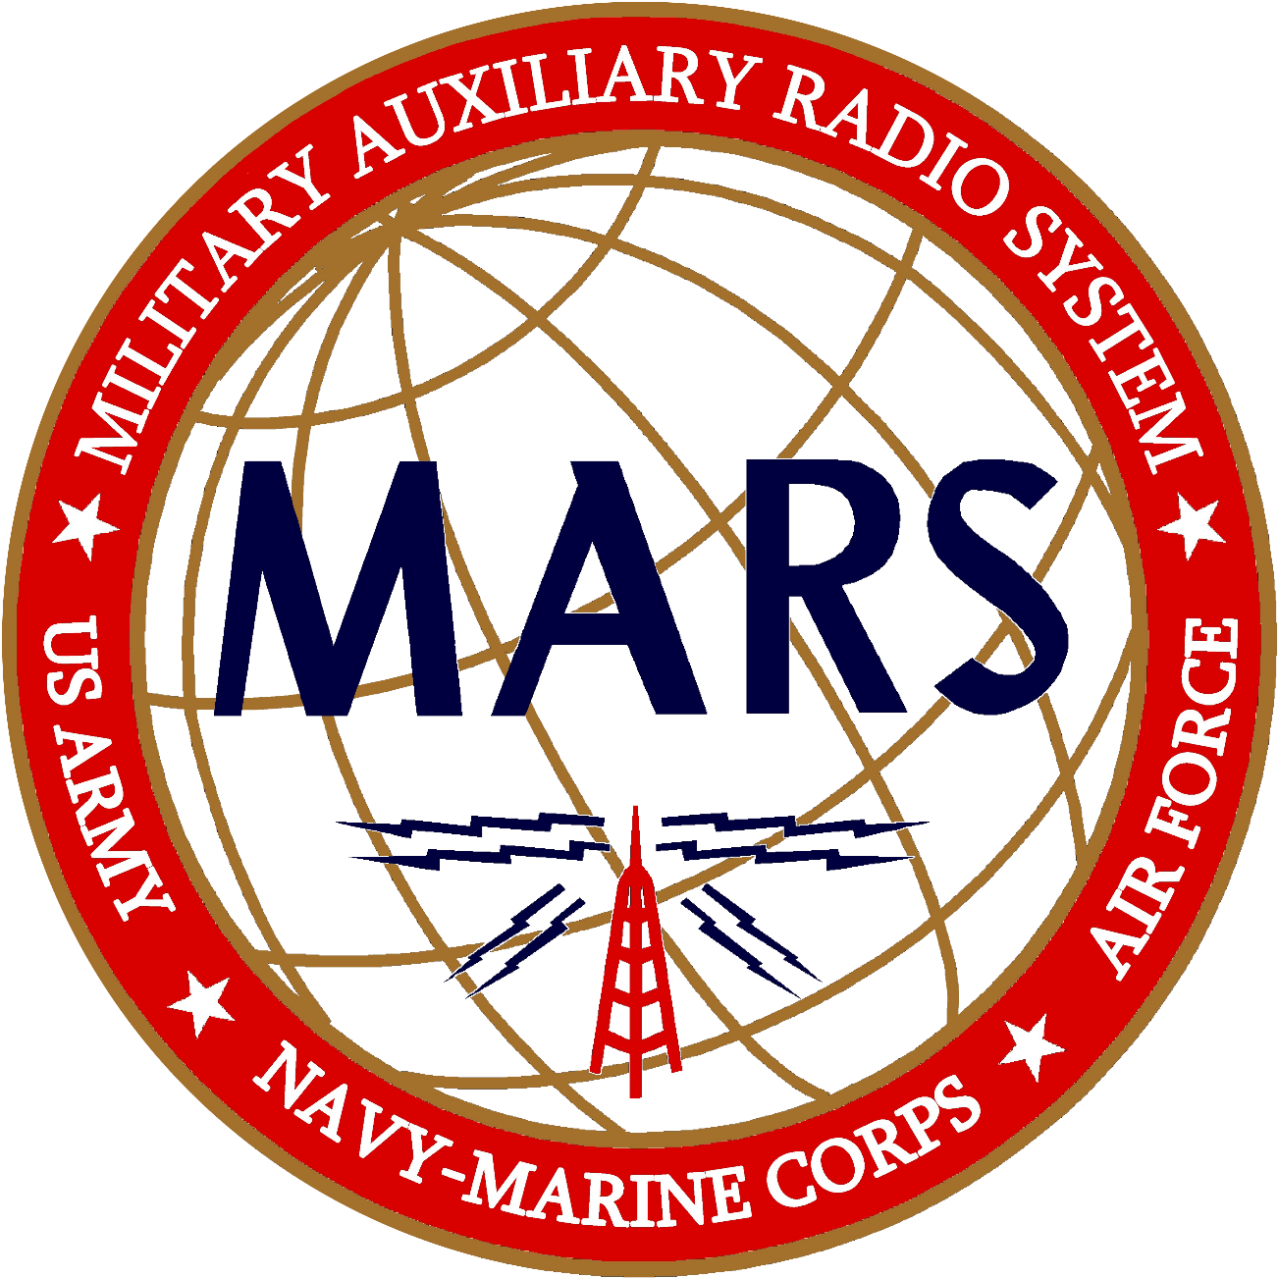
20 20
MAsteRS of the HF Domain
This Is A Public Presentation – UNCLASS - Unrestricted Distribution

Slide 3

This is the Face of AFMARS in the 21st Century
Modern Technology
More Operators, New Ideas
Updated DoD Mission Profile
Contingency Communications Capability in Uncertain Times
A Blending of Legacy Service and Modern Needs
Critical Military / Government Support

Slide 4
Effective November 2019 AFMARS Became A Unit of the New 16th Air Force.
AFMARS Is Now Part of Air Forces Cyber.
AFMARS is an Auxiliary of the USAF

Slide 5

The Legacy USAF MARS Program of the 24th Air Force was Stood Down on December 31st, 2019 and Simultaneously AFMARS 2020 was Stood Up Effective 0001Z 01 January 2020 – 16th Air Force.
First Major MARS Program Overhaul Since Vietnam Era Operations.

Slide 6

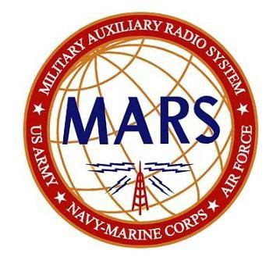
Why Change Air Force MARS?
Here is what happened:
Update Air Force MARS program to match today’s USAF missions and technologies, including Space Command
Restructure Air Force MARS to match Air Force nomenclatures & SOP
Identify and eliminate duplication of job efforts within MARS
Reduce number of HQ direct reports (streamline for efficiency)
Eliminate unnecessary processes and paperwork
Here is why it was done:
Air Force MARS mission has changed since Vietnam Era’s health and welfare phone patch calls from troops to family’s
Air Force MARS is an Air Force Auxiliary therefore, positions within MARS must follow Air Force job nomenclatures and descriptions
A significant number of positions at the region level are duplicated within states
Leaders are overwhelmed by the number of direct reports resulting in ineffective Span of Control

Slide 7
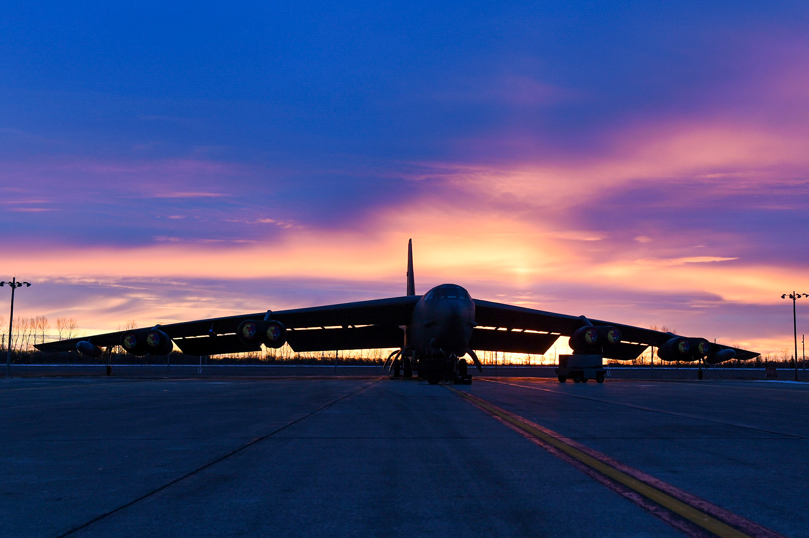

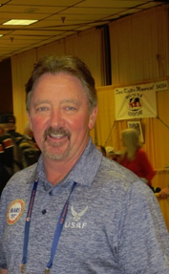
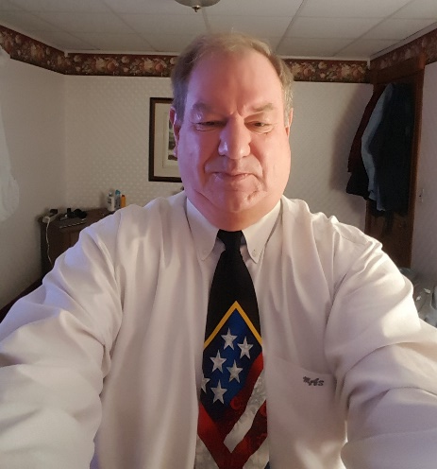
Dave Stapchuk
Chief USAF MARS
Call Sign – AGA5C
Mark Allen
Deputy Chief USAF MARS
Call Sign – AFG 1

Slide 8
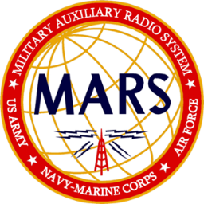
Partnering in Preparedness
Air Force MARS currently has approximately:
  1,050 active members
  100 emeritus members

Slide 9

Let’s Look Back In MARS History….. Way Back!

Slide 10
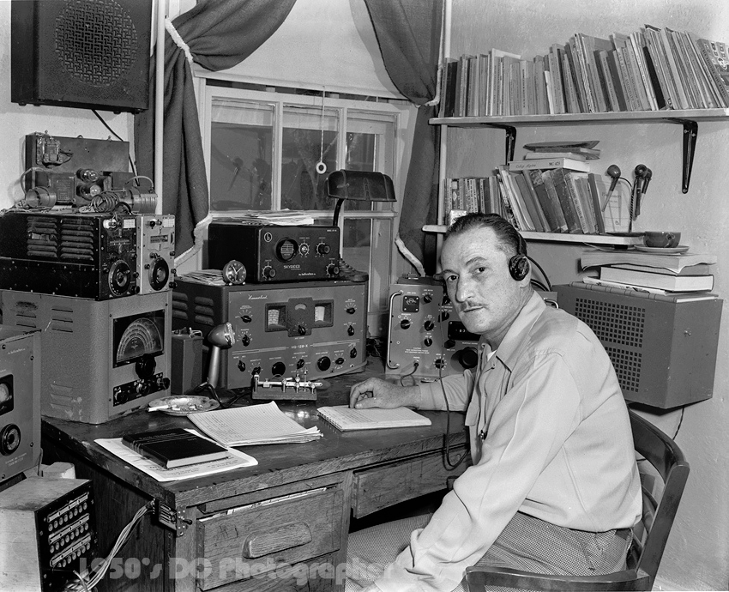
A Lot Has Changed, We Have Come A Long Way
Early 1950’s, Well Equipped Station

Slide 11

Remembering Our Legacy
MARS Program Photo on the Cover of RTN in 1951

Slide 12
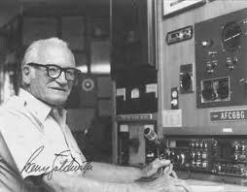
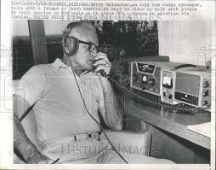
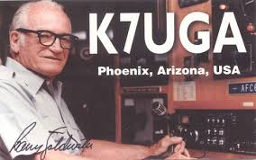
Remembering Our Legacy
Senator Barry Goldwater, K7UGA
AFA7UGA (AF MARS)
MARS Station Operator, Proponent and Ambassador

Slide 13
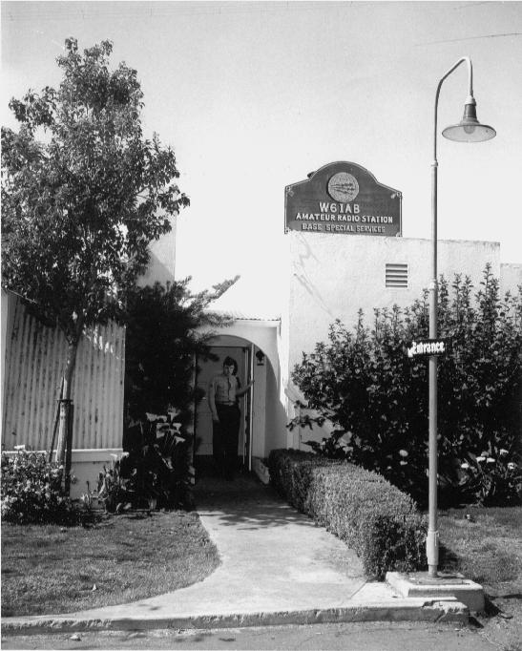
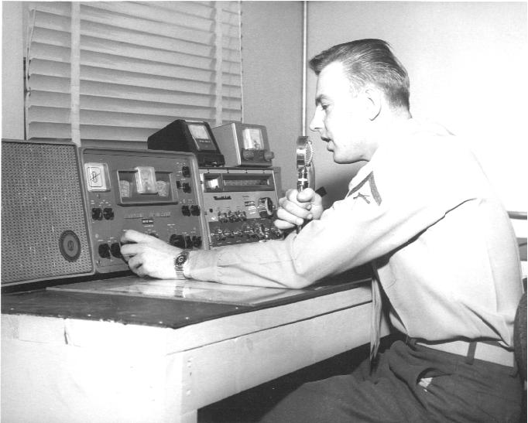
Remembering Our Legacy
W6IAB – Camp Pendelton, CA

Slide 14

Remembering Our Legacy
Ton Son Nhut Airbase
Vietnam, circa 1967
Chief Operator –
Sal Negro

Slide 15

Here’s AFMARS in 2020!
Our Members are On A Roll

Slide 16
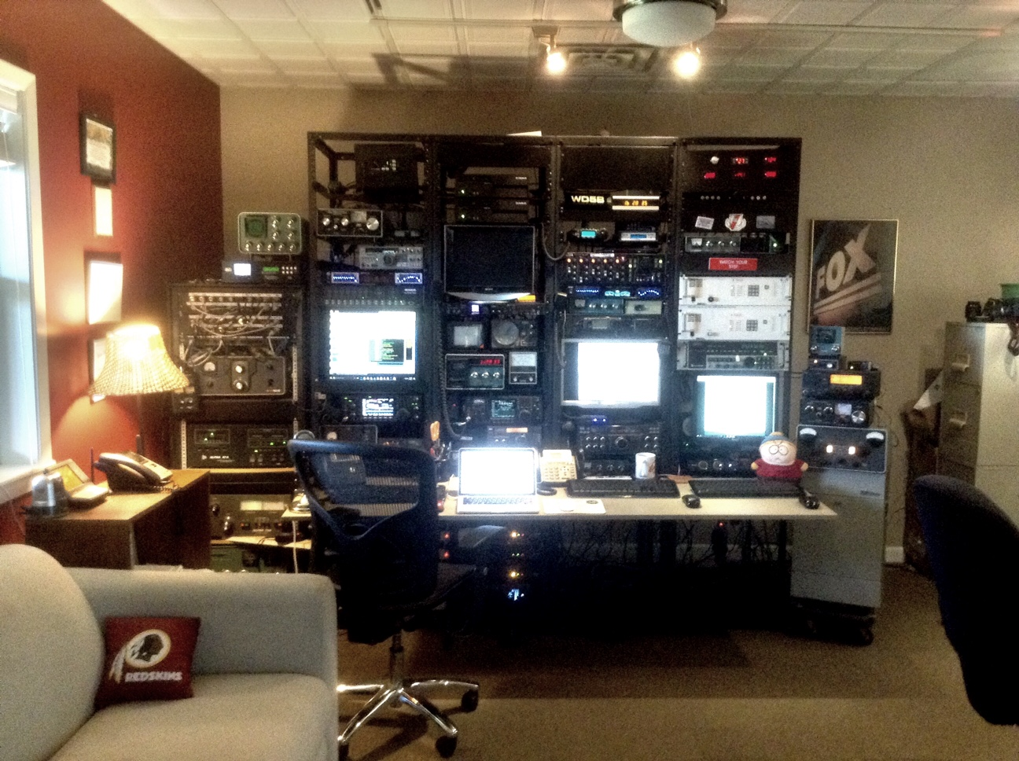
A Member’s Modern MARS Station

Slide 17

For Decades MARS was Known as an Organization on the Leading Edge of Technology and Experimentation
We Are On The Way Back !

Slide 18


MARS 2020
Is
Digital

Slide 19
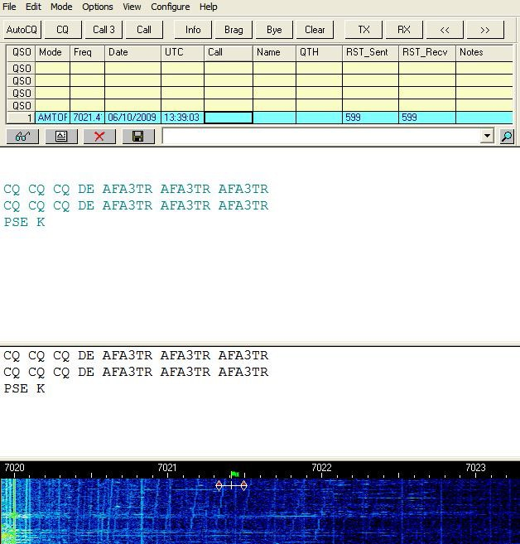
Multiple Communications Modes
AF Approved Data Modes
M110A (Primary)
MT-63
FT8 (AF)
Olivia (AF)
RTTY
Packet
CW
Transport Media
HF radio
VHF Radio
ALE HF Radio
WINLINK (AF only)

Slide 20
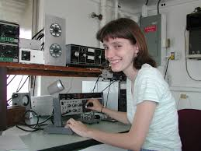
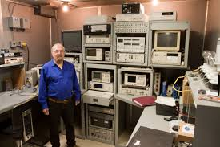

HF Digital Standards
Interoperability is here, today.
By DoD directive, all MARS services have migrated to M110A for official HF data transport uses.
Continuously greater emphasis being placed on encryption and secure data handling methods. Nearly all message traffic is secure.

Slide 21
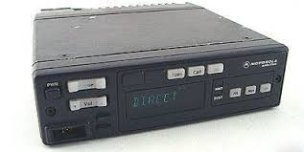
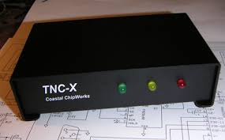
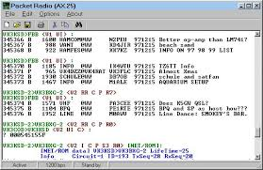
Short Haul Secondary & Tertiary Modes
Data Modes
AX.25 Packet
Transport Media
VHF Radio
Benefits
Inexpensive, readily available equipment
TNC controllers available from many sources
Low cost equipment
Free operating software

Slide 22
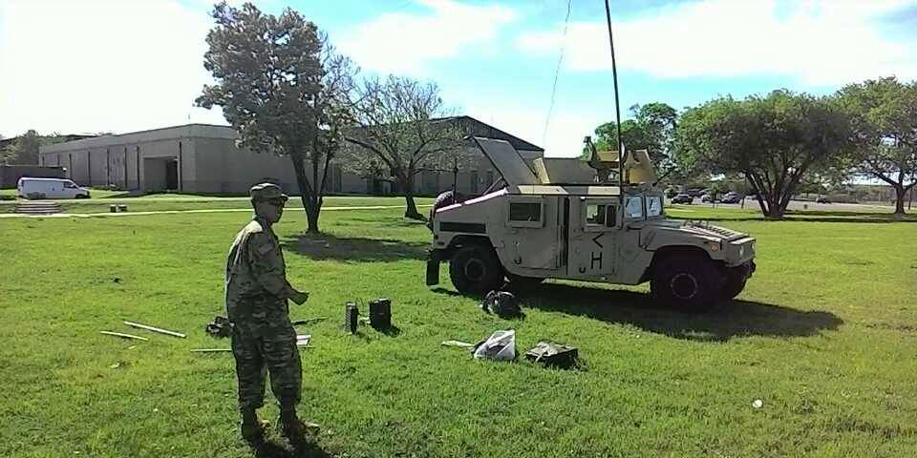
MARS Major Operational Missions & Efforts

Slide 23
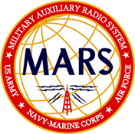
AFMARS Support During Civil Emergencies
Except as provided in Executive Order 13618 DOD DSCA support to DHS AFMARS is not normally involved in support to civil authorities.
If such support is to be provided, your Wing or Group Commander will receive specific tasking from headquarters. There are specific legalities which have to be adhered to regarding CFR Title 10 & 32.
Never “self-deploy” or offer AFMARS involvement without HQ approval.
Nearly, but not all, AFMARS call signs assigned to civil agencies have been revoked or allowed to expire. Most have moved to SHARES.
If you feel the need to get involved, do so as an amateur radio operator not using your MARS call sign.

Slide 24

SHARES HF Radio Program
MARS operators also participate in the National Shared Resources (SHARES) HF Radio Program
SHARES operates under the auspices of the DHS Office of Emergency Communications and helps ensure critical connectivity between government agencies during crisis situations
  Many Federal departments and agencies utilize HF radio communication systems to support their mission responsibilities
  These systems and the favorable propagation characteristics of the HF spectrum can be valuable assets during National Security and Emergency situations when regular communications links may be disrupted or destroyed

Slide 25
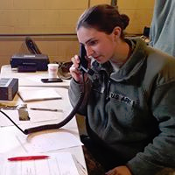
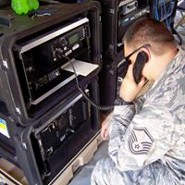
MARS in Action
Examples of MARS activities:
  Supporting DoD and DHS entities through training seminars on HF and VHF communications techniques (with active duty military)
  Supporting DoD and DHS entities through practicing the set-up and operations of equipment and on-the-air testing
  Forming a joint Base Support Team's to create a joint communications node tying together all MARS voice and data communications nets in CONUS and OCONUS
  Establishing a multi-mode digital training net to teach Air Force MARS and government operators digital transmission techniques

Slide 26
Cross - Service Collaboration
The requirement for greater coordination, collaboration and a unified MARS mission, among entities means that Air Force MARS members may check into nets and operate on frequencies assigned to Army MARS services and vice versa.
  Standardized procedures for voice nets have been promulgated
  Similar standardization procedures for digital nets are being considered
  Joint participation daily nets and quarterly exercises

Slide 27
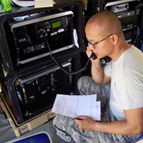
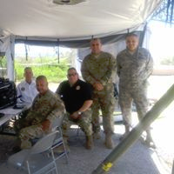
MARS – Opportunities to Participate
Significant events occurring in the year:
  A major inter-service operating exercise in each calendar quarter of the year – the COMEX (Communications Exercise)
    Involves participation of all MARS members
    Many collateral agencies / programs involved
      SHARES / DHS
      Civil Air Patrol
      National Guard
      Pentagon
      Other DoD operational units
      Certain other US Government agencies

Slide 28
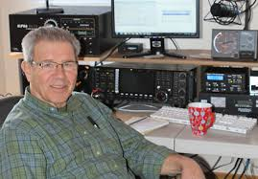
MARS HF Nets
(Some are AF or AR specific)
Regional Traffic Nets (daily)
State Administrative Nets (weekly)
TRANSGLOBAL: Voice and Digital Nets (daily)
TRANSGLOBAL : WinLink and ALE Networks (24/7/365)
MARSRADIO, aka, Phone Patch Net (24/7/365)
Military Support Net (daily)
Training Nets (daily)
Automatic Link Establishment (ALE) Nets (24/7/365)
ECOM Emergency Nets (quarterly exercises and actual incidents)
Regional Joint Service Interoperability Nets (RJMOG daily)

Slide 29

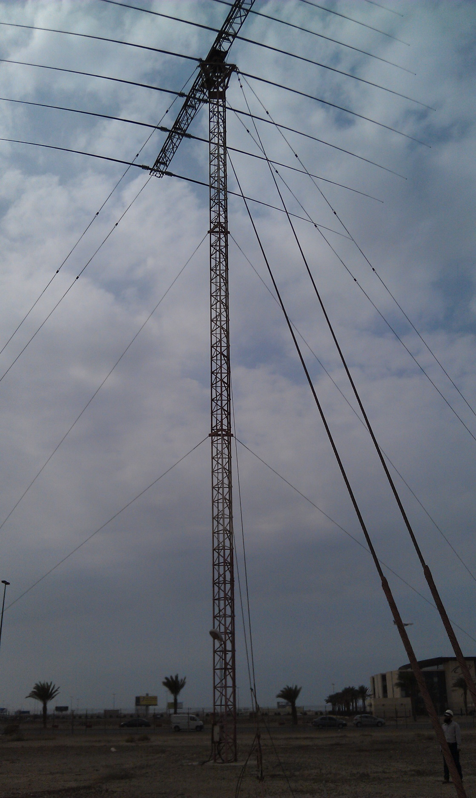
1st AFMARS SPECIAL OPERATIONS
MARSRADIO - AF MARS Phone Patch Net
CONUS & OCONUS Coverage

Slide 30
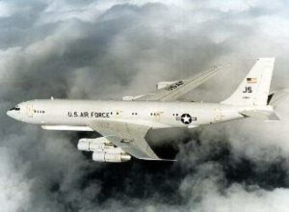
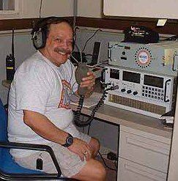
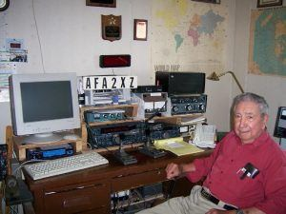
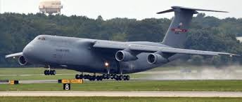
MARSRADIO
The Air Force MARS Phone Patch Net provides HF radio telephone service to aircraft from all branches of the U.S. military, Coast Guard, and the Department of Homeland Security
The net is staffed 24/7 by trained volunteers who are members of the Air Force MARS program
Air Force MARS operators facilitated well over 2,000 phone patches – nearly 200 a month – with more than 60 percent handling official business in support of operational activities over the last few years
More information can be found at: www.afmarsphonepatch.net

Slide 31





AF Military Support Net
(M S N)
Created by Air Force MARS in 2018 to provide contingency communications support in both voice and digital modes to contemporary military operations, homeland security and homeland defense activities, as well as CONUS and OCONUS disaster relief missions
Supersedes the legacy TRANSCON Space Support Net, which supported Space Shuttle launch and recovery operations
Is available to support other U.S. Government operations, including space activities

Slide 32
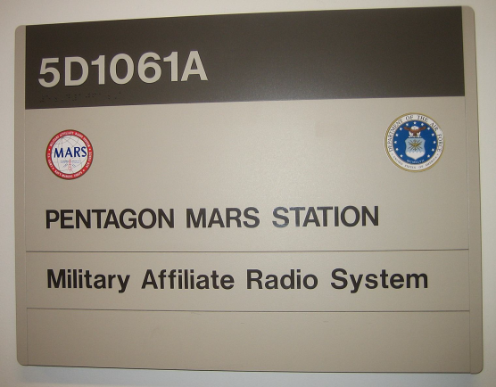
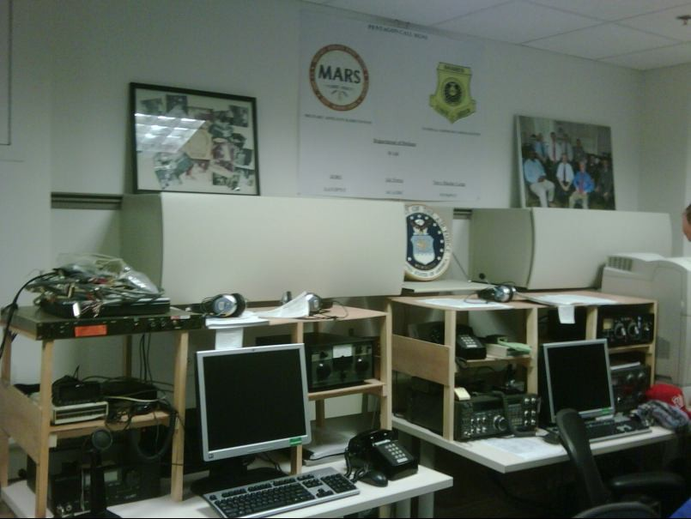
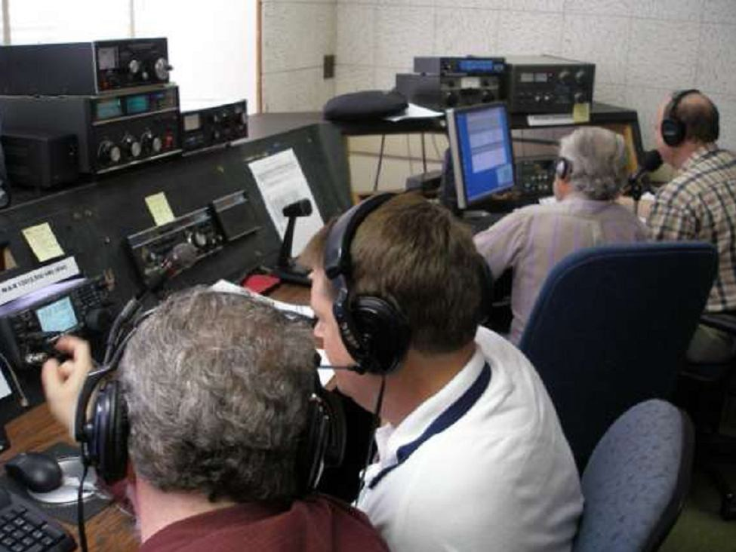
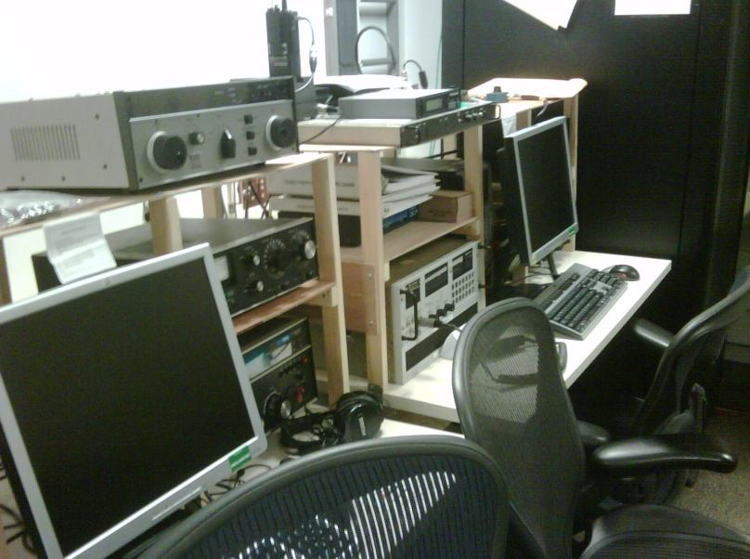
Air Force MARS at the Pentagon
The Pentagon MARS station operates under multiple call signs, including the Air Force MARS call sign AGA3DC, Army MARS call sign AAN3PNT, and Department of Defense call sign WAR
Air Force MARS members operating at the Pentagon MARS Station have participated in communications exercises with DoD airborne assets, receiving off-line encrypted messages and delivering them to the National Military Command Center for decoding and action

Slide 33
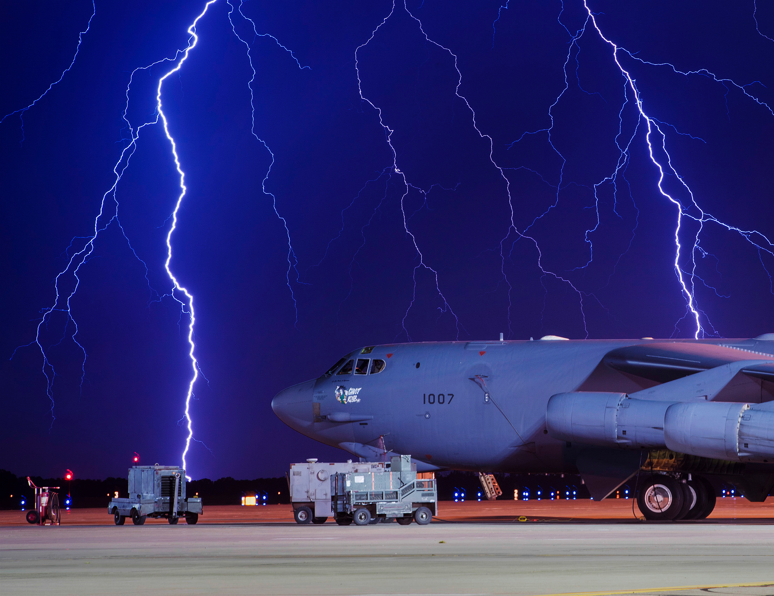
New Initiatives
In 2020

Slide 34
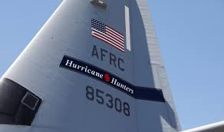

Developing Programs
AFMARS is in a developmental project
to provide secondary HF radio support
to the 53rd WRS, the “Hurricane Hunters”
Elements of AFMARS will provide SSB
voice and data support to aircraft in flight on weather
missions & hurricane hunting.
Currently on an experimental basis. 53rd
already utilizes MARSRADIO for some phone
patch traffic.

Slide 35

Want To Join Us?
If you have an interest in science, technology and communications, the USAF MARS could be for you. Apply your skills and hobby to serving those who serve our country. Must be 18 and hold any class of FCC amateur radio license. No license? We can help.

Slide 36
For More Information or
To Join AFMARS
Contact U.S. Air Force MARS National Recruiting Office
  Send an email query to – join@afmars-mil.us
  Dial – (888) 778-6277 for recorded program information and requirements to join.

Slide 37

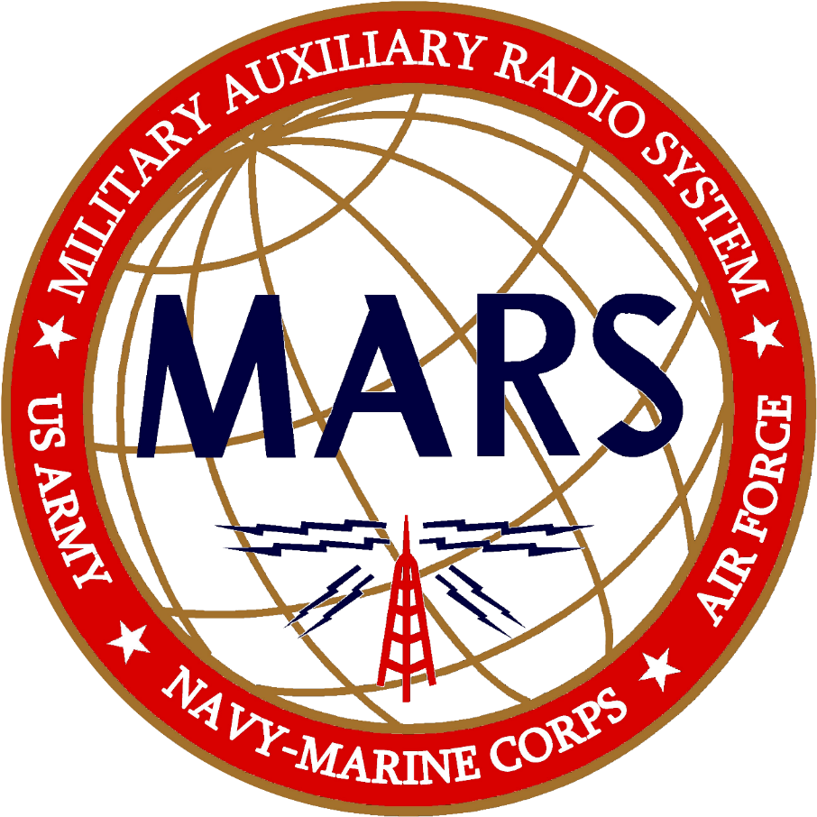
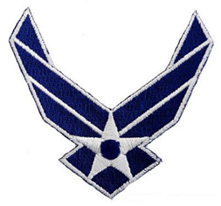
The Key to Your Future In Amateur Radio
Make Your Hobby Count For Something

